Slide 1
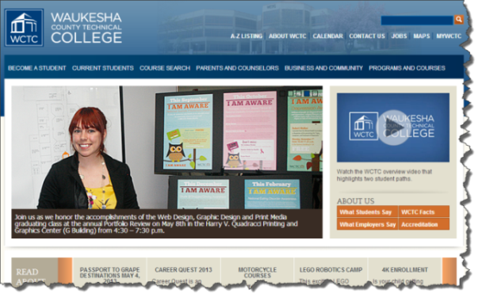
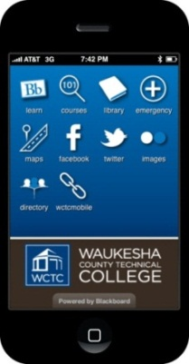
WCTC Student Technology Resources
Notes:
Welcome
Introduce yourself and your role at the college

Slide 2
Technology Resources Overview
WCTC Computing Resources
WCTC Email/Office 365
Online Learning
Blackboard
Mobile Applications
Notes:
Provide summary of the WCTC Student Technology Resources topics to be covered

Slide 3
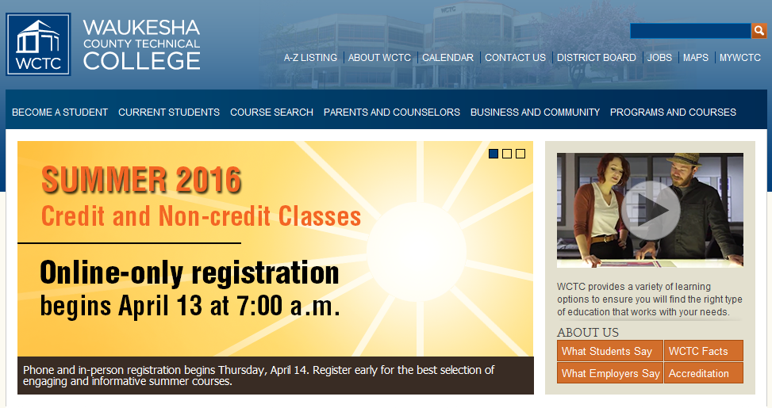
Computing Resources –www.wctc.edu
Notes:
Click and bring in the WWW graphic
Next click will bring in the WCTC home page
Explain where myWCTC is found
The gateway to your computing resources

Slide 4
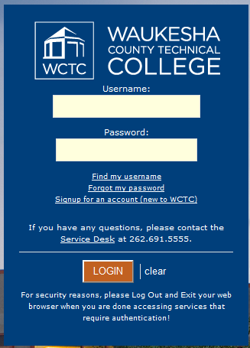
Authentication and Identification
Username – jstudent3 (Joe Student)
Password – default is your student ID#
Notes:
Provide an overview of student authentication and login
Username format
Password default
Talk about user name and password
Passwords are like your toothbrush “don’t share with anyone”
Encourage to change their PW by hitting CTL/ALT/DELETE and the 3rd option is change PW
MyCard acts as identification available at the Service Desk B-108 will be our new location
Fitness center
SGA events
Financial Aid
Printing
Library/Hub/Grind

Slide 5
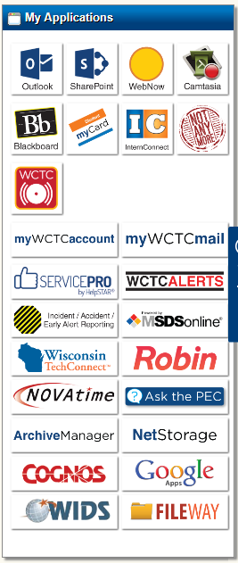
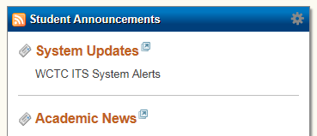
Your Portal/Applications
Notes:
The students application menu
My Account
Emphasizing where to find myWCTC Account and what’s in it
myWCTCmail
Blackboard
Technology Resources

Slide 6
WCTC uses Office 365
50GB of Email storage
Student Email Address –username@my.wctc.edu
WCTC will only send email to a student’s @my.wctc.edu address
Notes:
Introduce myWCTCmail and student cloud-based tools:
Student email - Outlook
Review format of student email address
Review college policy of sending official college email only to a WCTC student account
Review email forwarding issues (SPAM filtering)

Slide 7
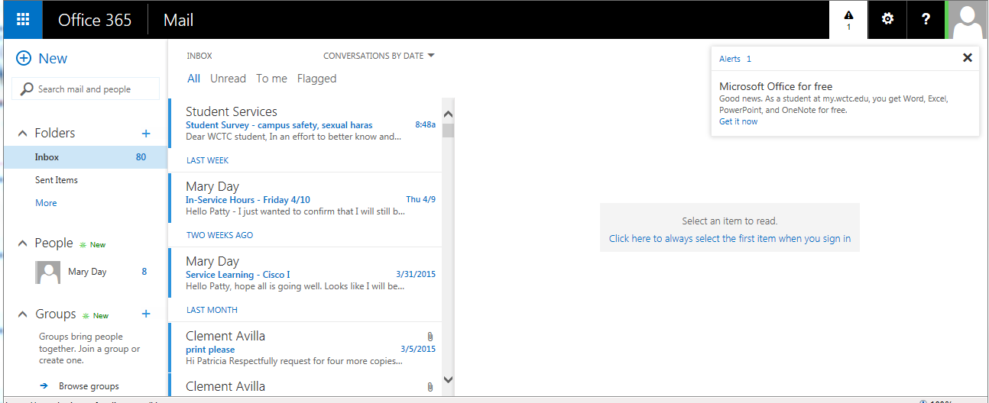
Notes:
With Outlook Live you can send and receive email on the Web and on your mobile phone. With this free email service to communicate with students and faculty, you’ll experience:
Full access to your email through the Web with Internet Explorer, Safari, or Firefox
Your own mailbox with a 10GB capacity
Access to your school’s email address book as well as your own personal address book (or one that you create), as well the ability to create new distribution lists
Calendar sharing and contact availability views for scheduling meetings
Access to your email from your compatible mobile device
Lifetime account
Features
Inbox – 50 GB
Calendar
Contacts
Tasks

Slide 8
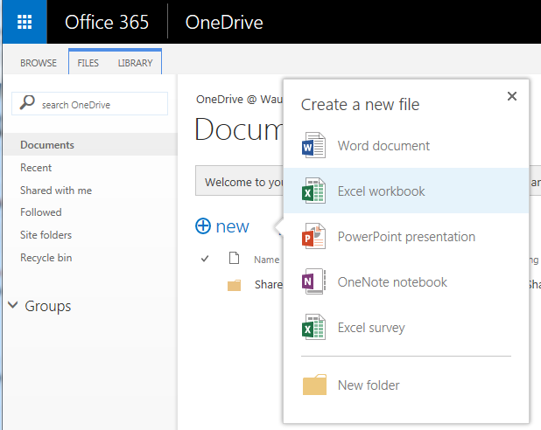
1 TB of FREE cloud file storage
Apps for your mobile device and PC
Get free office web apps
Click on New within your OneDrive
Notes:
OneDrive is a way to store your files online conveniently and securely. With OneDrive, you get 1 TB of free storage space you can use to:
Password-protect important files and folders
Manage all of your files, folders and subfolders
Share your OneDrive folders with contacts
Assign individual permissions (to read, modify, delete)
Use easy “drag and drop” file upload and sharing features

Slide 9
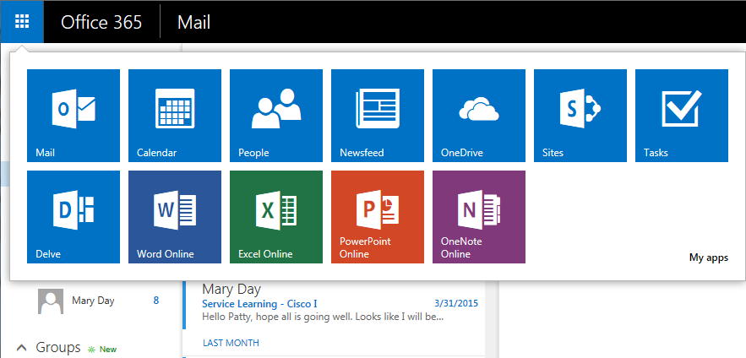
Office Web Apps within Email Account
Notes:
WCTC email account includes Office Web apps A.K.A Office 365 (main apps are Word, PowerPoint, Excel)
Saves automatically to OneDrive
Edit the files on line or in the full program
Also includes OneNote and Docs.com
Currently a free download to install Office 365 on your PC
Office Mobile and OneDrive also available in Google Play and the Apple store

Slide 10
Online Learning – Right for you?
Notes:
WCTC offers a variety of associate degree and continuing education courses via the Internet. These courses are designed for the independent student in need of a flexible learning option to fit their busy schedule. Students who choose Internet classes will use WCTC's web-based Blackboard course tool to complete homework, participate in class activities, and communicate with classmates and instructors.
Search for internet courses through the Course Search.
Courses delivered online can be a flexible and convenient way to take college-level courses, but students taking these courses need to disciplined, self-motivated and capable learners. Prior to registering for an Internet course it is important for students to carefully review their personal learning style, motivation and commitment to learning success.

Slide 11
WCTC Online Learning
Flexible
Convenient
Challenging
Online Learner Orientation Requirement
Required 5 hour course
Strategies for success
Reviews learning expectations
Technology skills and tools
Notes:
If you determine this method of learning is right for you and you are enrolling in your first WCTC online course – even if you have taken an online course in high school or at another college or university – you will be required to complete the mandatory online orientation prior to starting the regular online course.
The new orientation will be required for all new online learners registering for fall semester online classes.
The WCTC Online Learning Orientation course introduces new online learners to:
Technology requirements and tools used in online learning at WCTC.
Appropriate student skills and learning style requirements.
Student motivation and responsibilities for successful online course completion.

Slide 12
Online Learning with Blackboard
Faculty use this tool for:
Organizing and publishing course materials
Communication
Collaboration
Online Assessments
Course administration
Tracking online activities
Students use this tool to access:
Syllabus
Reference materials
Email instructors/students
Web links and activities
Grade Center
Discussion forums
Collaboration
Notes:
Blackboard is a web-based learning system used by WCTC for sharing instructional resources, engaging students for online interaction and for educational assessment. It is a web-based program/software built to enhance teaching methods and the learning processes of students. Every student has a Blackboard account and every course you enroll in will have a Blackboard section available.
Note: not all courses taught use the Blackboard system

Slide 13
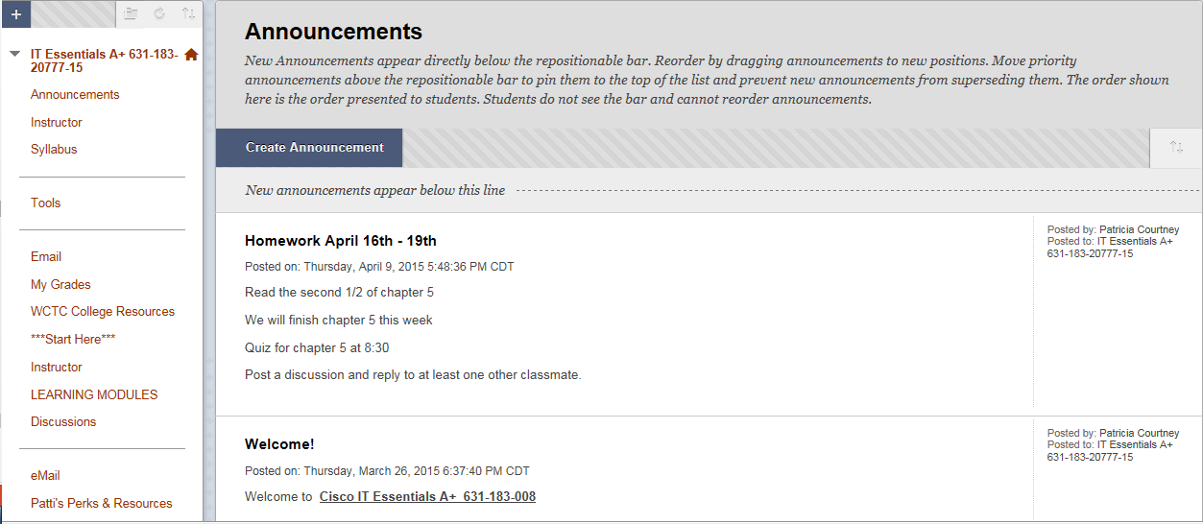
Blackboard Course
Navigate Here
Read, explore, learn here

Slide 14
Get the WCTC Learn Mobile App
Notes:
Using WCTC Learn, you get:
1. Instant Course Access. View and post back to key areas of your Blackboard courses and organizations, including Announcements, Discussion Boards,
Blogs and Journals.
2. Network and Wireless Connectivity. Access your courses on your cellular provider’s network or over Wi-Fi using select Android and Apple® iPad™, iPod touch® and iPhone® devices.
3. Free Mobile App. Download the “WCTC Learn” app from the app store for your device at no cost.
4. WCTC Learn Campus. Extends access to important campus resources that include:
• Class Search
• Library
• Emergency Numbers
• Maps
• WCTC Social Media
• Campus Images

Slide 15
Printing on Campus
www.wepanow.com
Notes:
Cloud based printing
$34 allotment for as long as you are a student
You can pay with your myCard or you can use a credit card
You can print from any computer on campus or from your USB drive
Download the drivers to your personal device at WEPAnow.com
Print anywhere there is a kiosk

Slide 16
Secured Wireless for Students
Choose WCTC Secure Wireless
Use your WCTC credentials to log on to the network
If you connect using the WCTC guest first you must forget it

Slide 17
Email-servicedesk.wctc.edu
Call 262-691-5555
Notes:
Supports all technology issues
Wireless
Email on mobile devices
Printing
WCTC owned computers
Software applications

